Slide 1
Years 3, 4 &5 - Maths Calculation Strategies
Wednesday 3rd December 2020

Slide 2
Aims of the workshop
Written methods for all 4 operations: Addition, subtraction, multiplication and division
How you can support at home
Preparation for the Year 4 ‘Multiplication Tables Check’
Questions

Slide 3
Written Strategies - Addition

Slide 4
Written Strategies - Subtraction

Slide 5
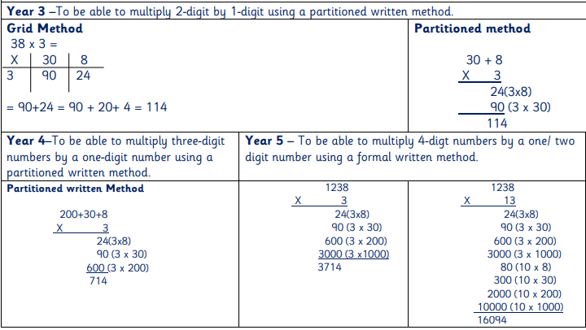
Written Strategies - Multiplication

Slide 6
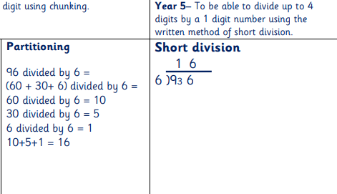
Written Strategies - Division

Slide 7
Year 4 Multiplication Tables Check
www.gov.uk has not updated their information for the 20/21 academic year as yet.
Purpose: To determine whether pupils can recall their times tables fluently. Support schools in identifying pupils who need additional support.
https://www.gov.uk/government/publications/multiplication-tables-check-information-for-parents

Slide 8
Year 4 Multiplication Tables Check
What is the process?
The MTC is an on-screen check consisting of 25 times tables questions. Your
child will answer 3 practice questions before moving on to the offcial check, and
will then have 6 seconds to answer each question. On average, the check should
take no longer than 5 minutes to complete.

Slide 9
Year 4 Multiplication Tables Check
Schools have a 3 week window to administer the test – scheduled from Monday 7th June 2021.
Can be administered individually, in small groups or as a whole class.
A ‘Try it out’ area is open from March for pupils. Allowing them to practice using the computer program. Also allows teachers to assess if any pupils need support in accessing the test.

Slide 10
Year 4 Multiplication Tables Check
How we are supporting in school:
Regular times table sessions
Mental arithmetic sessions weekly
Completion of times table grids and quiz questions
‘Times Table Rockstars’ competitions
‘Sound Check’ assessments half termly
Extra support where needed

Slide 11
Year 4 Multiplication Tables Check
How can you help at home?:
Practising specific times tables that your child needs support with
Completion of times table grids.
Using ‘Times Table Rockstars’ at home
Free online games such as: https://www.timestables.co.uk/

Slide 12
How can you support at home:
Completing homework using the strategies discussed and shown.
Informing your child’s class teacher if you find that your child is finding a certain aspect of maths a challenge at home.
Allow your child time to practice their times tables.
Use maths in every day settings for example: money when you go shopping, discussing time and measures when cooking etc.
If you are interested there are a wide range of text to support your child available. The CGP series is particular useful in given example questions to help their learning.
Coming up…
A Mathematic Reasoning Workshop.
Date TBC

Slide 13
Questions

